Slide 1
STOCK MARKET PREDICTION USING LINEAR REGRESSION
BY
SHANTANU BADWE
SWARAJ BUCHUDE
PARTH JAMDADE
NILEET SAVALE
Under The Guidance Of Dr. S.N. Zaware (HOD)

Slide 2
WHAT IS STOCK MARKET ?
Stock market is a collection of buyers and sellers which show their interest with the trading of stocks which are released by the companies for elevating the capital and are bought by the investors in order to get a portion of the company.
It is a place where shares of public listed companies are traded. The primary market is where companies float shares to the general public in an initial public offering (IPO) to raise capital.

Slide 3
WHAT IS STOCK MARKET PREDICTION ?
Stock market prediction is the act of trying to determine the future value of a company stock or other financial instrument traded on an exchange. The successful prediction of a stock's future price could yield significant profit. The efficient-market hypothesis suggests that stock prices reflect all currently available information and any price changes that are not based on newly revealed information thus are inherently unpredictable.

Slide 4
HOW TO PREDICT STOCKS WITH HELP OF MACHINE LEARNING ?
One can show machine learning models vast amounts of historical data of a company’s stock (several decades' worth of data) and use the model to extract key trends and essential features that define the company’s stock performance. If such trends, parameters, and features are extracted effectively, the model can predict future stock performance.

Slide 5
OBJECTIVE AND PURPOSE OF STOCK MARKET PREDICTION
Predicting Stock Market to gain significant profits.
To make it user friendly and easy to use.
To make calculations with high approximation.
The algorithm is designed with minimal complexity and helps the user to make safe and accurate decisions with accurate price prediction.

Slide 6
ALGORITHMS FOR PREDICTING STOCKS
SUPERVISED
UNSUPERVISED
Long Short Term Memory (LSTM)
Linear Regression
Support Vector Machine (SVM)
Decision Tree (DT)
Random Forest (RT)
Restricted Boltzmann Machine (RBM)
K means Clustering
Hierarchical Clustering

Slide 7
DECISION TREE
A decision tree is a non-parametric supervised learning algorithm, which is utilized for both classification and regression tasks.
It has a hierarchical, tree structure, which consists of a root node, branches, internal nodes and leaf nodes.
Decision tree learning employs a divide and conquer strategy by conducting a greedy search to identify the optimal split points within a tree.
This process of splitting is then repeated in a top-down, recursive manner until all, or the majority of records have been classified under specific class labels.

Slide 8
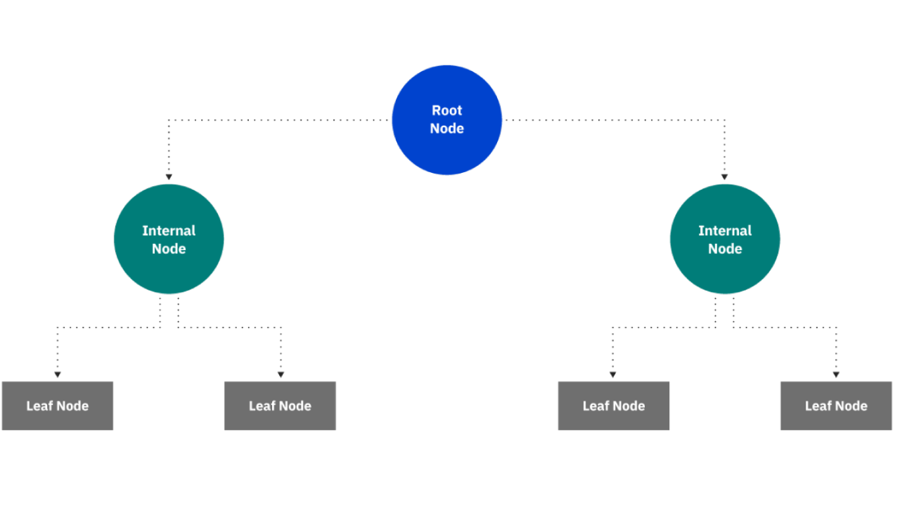

Slide 9
HOW IT WORKS?
A decision tree starts with a root node, which does not have any incoming branches. The outgoing branches from the root node then feed into the internal nodes, also known as decision nodes. Based on the available features, both node types conduct evaluations to form homogenous subsets, which are denoted by leaf nodes, or terminal nodes. The leaf nodes represent all the possible outcomes within the dataset.

Slide 10
Advantages
Easy To Interpret
Little to no data preparation required
More Flexible

Slide 11
Disadvantages
Prone to overfitting
High variance estimators
More costly
Not fully supported in scikit-learn

Slide 12
LONG SHORT TERM MEMORY ( LSTM )
Long Short Term Memory is a kind of recurrent neural network.
It tackled the problem of long-term dependencies of RNN in which the RNN cannot predict the word stored in the long-term memory but can give more accurate predictions from the recent information.
It is used for processing, predicting, and classifying on the basis of time-series data.

Slide 13
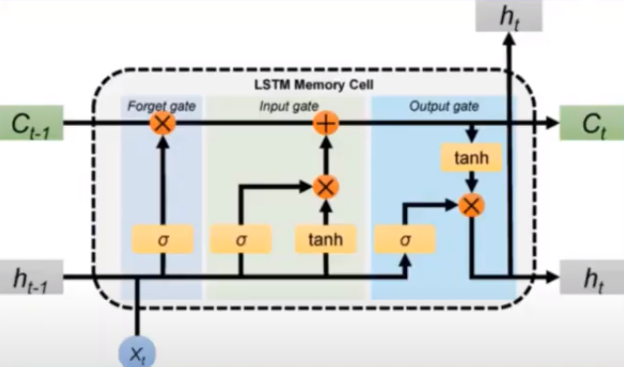
STRUCTURE OF LSTM

Slide 14
STEPS TO BUILD LSTM
Define Network
Compile Network
Fit Network
Predict

Slide 15
K MEANS CLUSTERING
K-Means Clustering is an Unsupervised Learning algorithm, which groups the unlabeled dataset into different clusters.
It is a centroid-based algorithm, where each cluster is associated with a centroid.
The main aim of this algorithm is to minimize the sum of distances between the data point and their corresponding clusters.

Slide 16
MAIN OBJECTIVE
The k-means clustering algorithm mainly performs two tasks:
Determines the best value for K center points or centroids by an iterative process.
Assigns each data point to its closest k-center.
Those data points which are near to the particular k-center, create a cluster.

Slide 17
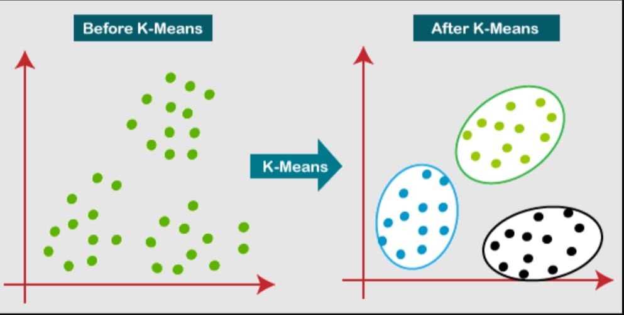

Slide 18
ADVANTAGES OF K MEANS CLUSTERING
Relatively simple to implement.
Scales to large data sets.
Guarantees convergence.
Easily adapts to new examples

Slide 19
LINEAR REGRESSION
Linear Regression is a machine learning algorithm based on supervised learning.
It performs a regression task.
Regression models a target prediction value based on independent variables.
It is mostly used for finding out the relationship between variables and forecasting

Slide 20

The most basic machine learning algorithmic rule that may be enforced on this information is regression.
The regression model returns associate degree equation that determines the link between the independent variables and therefore the variable.
The equation for regression may be written as:

Slide 21
HOW LINEAR REGRESSION WORKS ?
Linear regression performs the task to predict a dependent variable value (y) based on a given independent variable (x).
So, this regression technique finds out a linear relationship between x (input) and y(output).
Hence, the name is Linear Regression.
In the figure above, X (input) is the work experience and Y (output) is the salary of a person.
The regression line is the best fit line for our model.

Slide 22
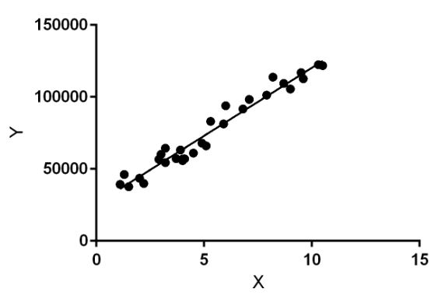

Slide 23
MEAN SQUARED ERROR ( MSE )
The Mean squared error (MSE) represents the error of the estimator or predictive model created based on the given set of observations in the sample.
It is used to represent the cost associated with the predictions or the loss incurred in the predictions.
The lesser the MSE, the better the regression model.
It is the difference between Actual value & Predicted value.

Slide 24
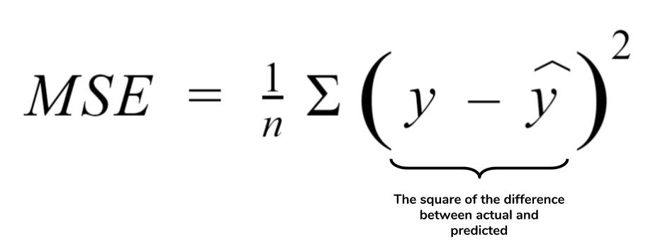

Slide 25
CONCLUSION
It has led to the conclusion that it is possible to predict stock market with more accuracy and efficiency using machine learning techniques.
In the future, the stock market prediction system can be further improved by utilizing a much bigger dataset than the one being utilized currently.

